Slide 1
Employee Data Analysis using Excel
STUDENT NAME: RISHIVANDYA K S V
REGISTER NO: F91C9399891F4A28F9A40C4C6017ECC2, 122201875
DEPARTMENT: BCOM CORPORATE SECRETARYSHIP
COLLEGE: MEENAKSHI COLLEGE FOR WOMEN KODAMBAKKAM

Slide 2
PROJECT TITLE
Employee Performance Analysis Based on Department, Gender and Salaries using excel

Slide 3


AGENDA
Problem Statement
Project Overview
End Users
Our Solution and Proposition
Dataset Description
Modelling Approach
Results and Discussion
Conclusion
3/21/2024 Annual Review

Slide 4

PROBLEM STATEMENT
To analyze employee performance across different departments, genders, and salary levels to identify trends, disparities, and areas for improvement in organizational areas for improvement in organizational practices. This analysis aims to support the organization’s goals of enhancing employee performance while fostering an inclusive and equitable workplace.

Slide 5

PROJECT OVERVIEW
Analyzing performance metrics through the lenses of department, gender, and salary can provide valuable insights that help drive strategic initiatives, improve employee engagement, and initiatives, improve employee engagement, and promote diversity and equality in the workplace. By addressing potential disparities and promoting equitable practices, the organization can cultivate a more motivated and highperforming workforce.

Slide 6

WHO ARE THE END USERS?
~HUMAN RESOURCE DEPARTMENTS
~MANAGEMENT AND LEADERSHIP. ~TEAM LEADERS AND SUPERVISORS ~TEAM LEADERS AND SUPERVISORS
~EMPLOYEES
~EXECUTIVE LEADERSHIP
~BUSINESS ANALYSTS
~RECRUITERS

Slide 7

OUR SOLUTION AND ITS VALUE PROPOSITION
PIVOT TABLE –SUMMARY OF EMPLOYEE PERFORMANCE BAR DIAGRAM –FINAL REPORT

Slide 8
Dataset Description
EMPLOYEE DATA SET –NAN MUDHALVAN PORATAL
9 FEATURES IN EXCEL:
EMPLOYEE ID –ALPHANUMERIC (TEXT)
NAME –ALPHABETICAL (TEXT)
GENDER –ALPHABETICAL (TEXT)
DEPARTMENT –ALPHABETICAL (TEXT)
SALARY -NUMERICAL SALARY –
NUMERICAL START DATE –ALPHANUMERIC (TEXT) FTE - NUMERICAL EMPLOYEE TYPE –ALPHABETICAL (TEXT) EMPLOYEE LOCATION –ALPHABETICAL (TEXT)
3 FEATURES USED:
DEPARTMENT –ALPHABETICAL (TEXT)
SALARY -NUMERICAL
GENDER –ALPHABETICAL (TEXT)

Slide 9

THE "WOW" IN OUR SOLUTION
This analysis offers a clear understanding of how department. Gender and salary influence employee performance. By addressing the identified trends and addressing the identified trends and implementing the recommended strategies, the organization can foster a more effective, supportive, and performancedriven work environment.
3/21/2024 Annual Review
9

Slide 10
MODELLING
STEP-1 DOWNLOAD THE EMPLOYEE DATASET AND OPEN THE EMPLOYEE DATASET IN EXCEL.
STEP-2 SELECT THE ENTIRE DATA AND CLICK ON INSERT AND CLICK ON PIVOT TABLE TO CREATE PIVOT TABLE.
STEP-3 DRAG THE NEEDED DATA AND CREATE A PIVOT TABLE. 1
STEP-4 SELECT THE PIVOT TABLE AND CLICK ON INSERT.
STEP-5 NOW CLICK ON THE CHART THAT YOU WANT.
STEP-6 THE CHART IS CREATED.
10

Slide 11
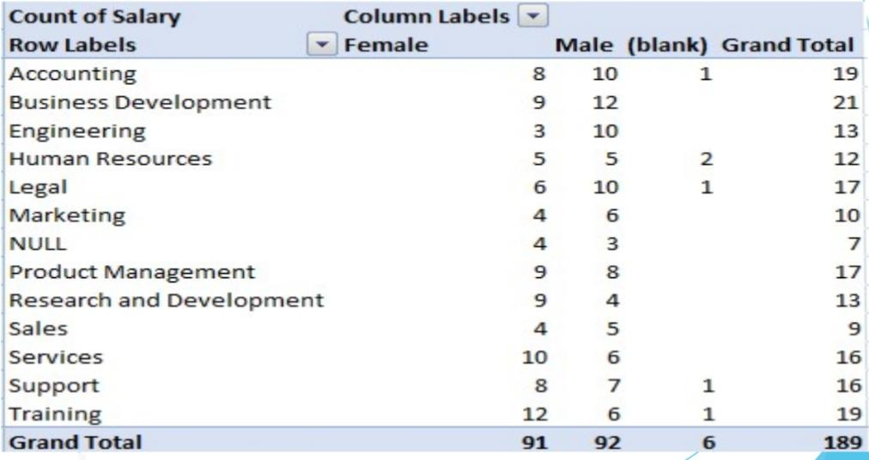
RESULTS
1. TABLE 1
11

Slide 12
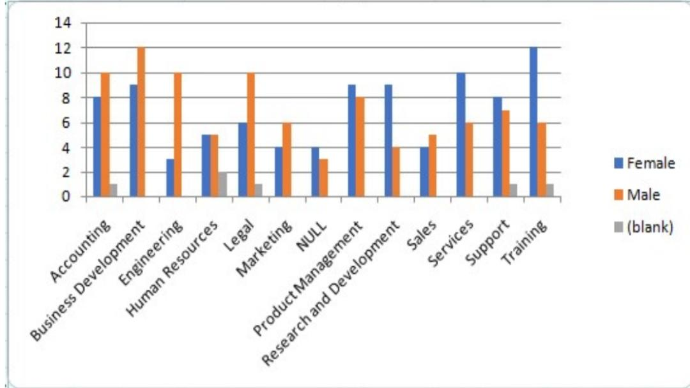
2. BAR DIAGRAM

Slide 13
conclusion
The analysis of employee performance, segmented by
department, gender, and salary, has provided valuable
insights into how these factors interact and influence
performance outcomes within the organization. This
analysis underscores the importance of departmental
strategies, equitable performance management, and the
nuanced relationship between salary and performance.

